Slide 1

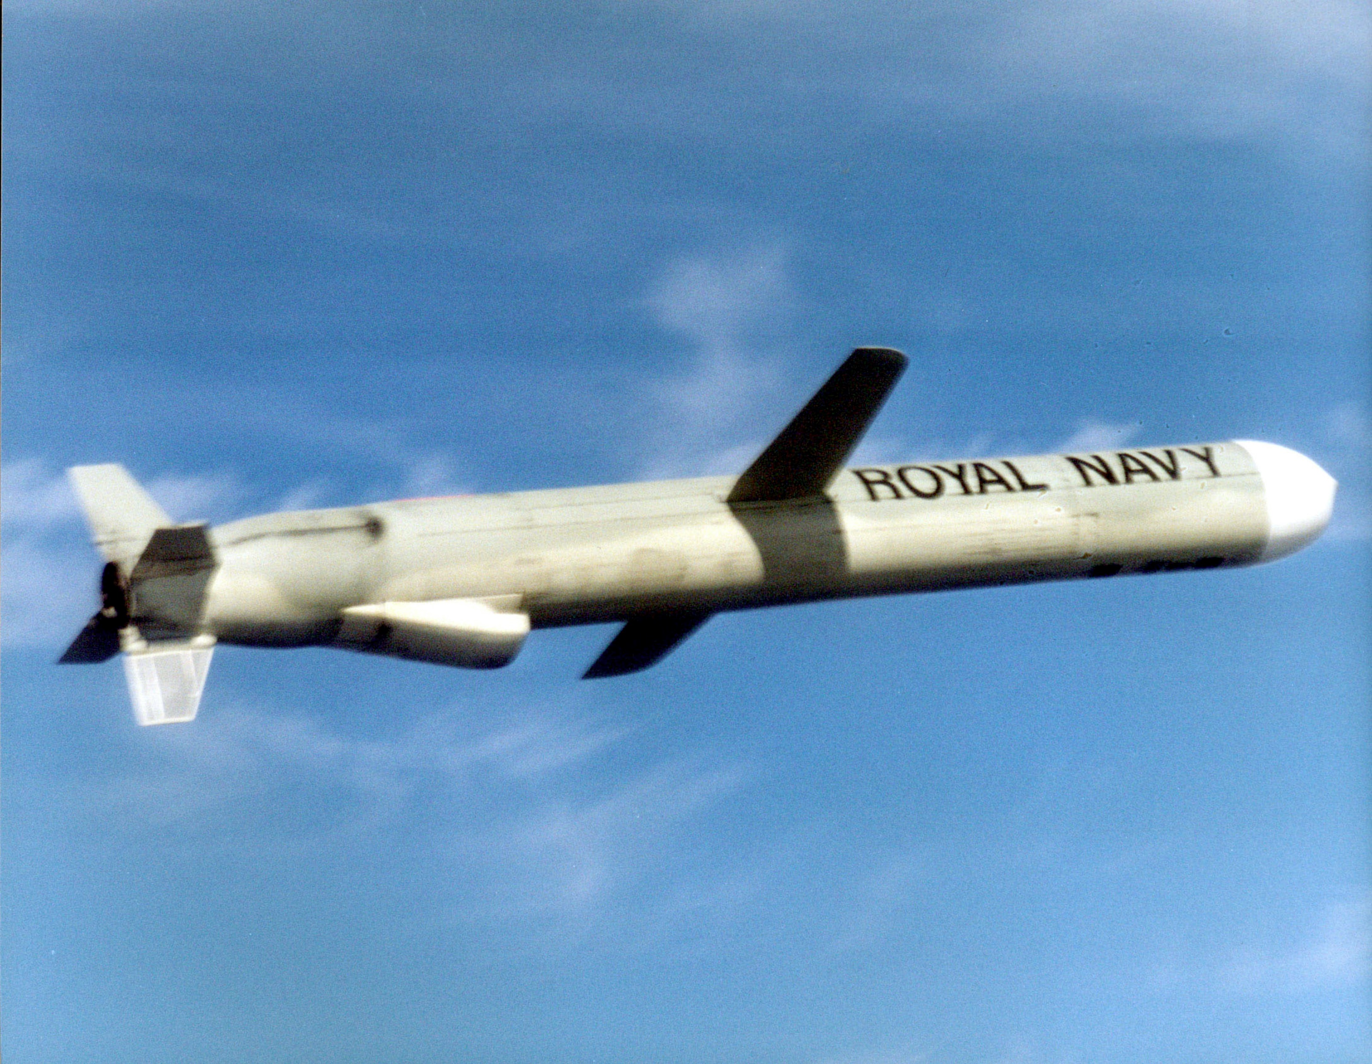


2015 – 2040
APAC JP-10 MARKET
FORECAST & OPPORTUNITIES
Prepared for :
MARKET INTELLIGENCE . CONSULTING
www.techsciresearch.com

Slide 2
Market Overview: APAC JP-10 Market
APAC JP-10 Market Size, By Value, 2026F, 2030F, 2035F, and 2040F (USD Million)
Global JP-10 Market Size, By Value, 2015, 2020, 2021E, and 2040F (USD Million)
JP-10 is only used in the USA to date. But recently in India, DRDO (Defence Research and Development Organisation) has proposed to use JP-10 in its missiles in the future due to awareness about the advantages of this jet fuel. Whereas in China, due to the highest production of DCPD in comparison to other countries, it is anticipated that China might invest in the production of JP-10 and use it in their respective defense field. As per the information received from market participants, increased availability is likely to soften the prices in APAC region which is likely to create potential demad i APAC region including India.
Currently, JP-10 is used in the defense sector as a fuel for missiles. Increase in the missile numbers till the forecasted period will increase the market from the demand side. Various pilot projects on Bio-based JP-10 is said to reduce the cost limitation associated with it to use in commercial aviation. Majority of the JP-10 fuel is currently used in US. However, Research & Development of various emerging countries of APAC and Europe are monitoring and developing a product for their market.
Global Jet Fuel Military Grade (JP-4, JP-5, JP-8, JP-10) Market Size, By Value, 2015, 2020, 2021E and 2040F (USD Billion)
US JP-10 Pricing Analysis, 2015, 2020, 2021E, 2040F(USD Per Gallon)
Majority of Jet fuel used in Military application are JP-4, JP-5, JP-8 and JP-10. The composition of these fuels are very similar. Predominantly consists of C9–C16 hydrocarbons that are a combination of n-paraffins, isoparaffins, naphthenes, and aromatics. Rapid Economic Development and increasing security threat led to substantial increase in defense resources. Increasing budget in Procurement and R&D activities in global defense will increase the fighter jets in upcoming years.
The price for JP-10 fuel is expected to reduce for the forecasted period. Many research and development activities are identifying route to manufacture JP-10 fuel from bio route. Increased availability of the product will result in consistent decline of price during forecast period.
Source: TechSci Research

Slide 3

Recommendations for HPCL
According to DRDO, most of the propellant engine used in India consists of oxidizer. However, researches are working on developing cost-efficient technologies which can utilize atmospheric oxygen for combustion. Engines utilizing ramjet and scramjet are most focused propulsion system for future transportation for DRDO. Due to atmospheric air intake, these engines will be requiring high energy with high density. The fuel required for these engines will be the fuel having higher density compared to currently used Jet-A fuel. Being a higher density fuel. JP-10 has a future potential to replace conventional fuel for future aircraft and missile technology.
However, it is not commercially available currently in India, therefore, there is a need to develop high density JP-10 fuel in the country. The most important requirement of the missile fuel is to put more available energy in each unit of volume. Country like Japan, America, China etc. are manufacturing for their missile systems.
The production of JP-10 is majorly demand driven and current development in India for the product is still at research level and thus it is recommended for HPCL that to before setting up the facility for JP10, HPCL to work closely with defense organizations of the country to understand the development regarding missiles and aircraft using these fuels and technical specification required for JP 10.

